Slide 1
“The Customer Is Always Right(?)” NADN Survey of Litigators, Sep 2020

Slide 2
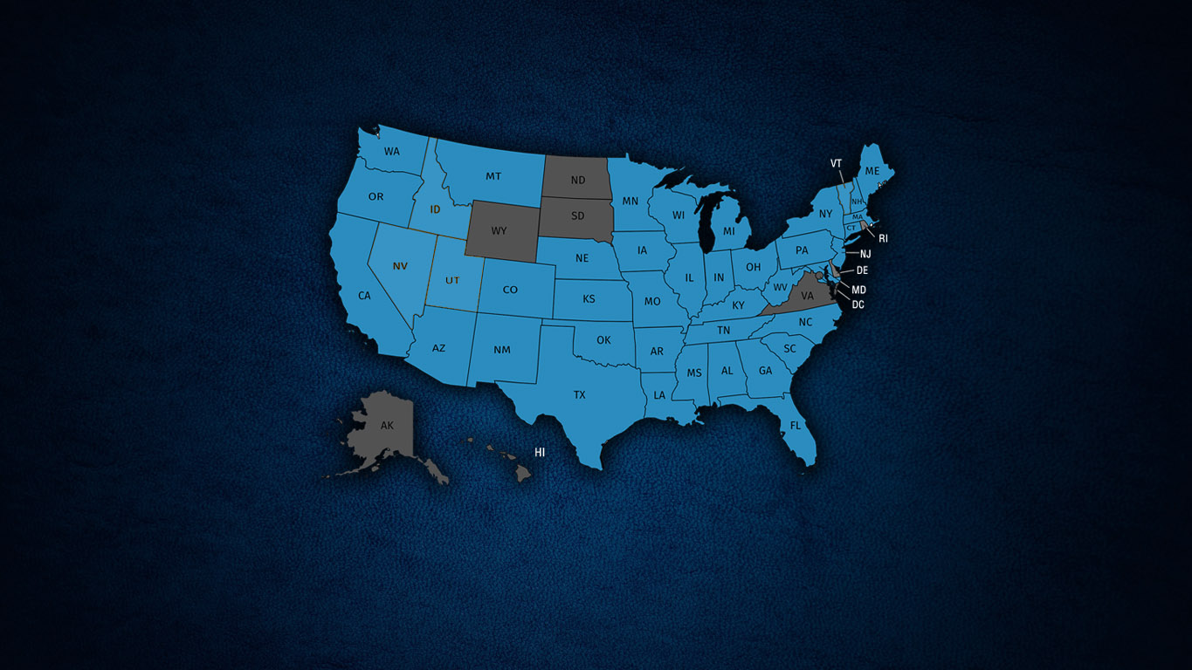
Current NADN Membership - 1121
Members in all 50 states + DC
Formal State Chapters with local websites in 42 States
As of Sep 23, 1002 members (89%) are primarily using Zoom to mediate/arbitrate

Slide 3
ODR HAS FINALLY ARRIVED…
For years on the fringes, more often for non-litigated cases: family disputes, small claims, domain names, eBay disputes, etc.
Only 2% of litigators had EVER attended a mediation or arbitration by video
before March 2020…

Slide 4
ODR HAS FINALLY ARRIVED…
…now, almost 95% of surveyed litigators are
primarily attending meetings via Zoom/online.
* Survey conducted by SurveyMonkey, 500 litigators responded (250 DRI / 250 AAJ)

Slide 5
6 months on, what do litigators think…?
Question 1:
Generally, how would you rate your ability to effectively advocate for your client via Zoom/video platforms, as compared with traditional in-person mediations?
SAME, BETTER or WORSE?

Slide 6
6 months on, what do litigators think…?
Question 1:
Generally, how would you rate your ability to effectively advocate for your client via Zoom/video platforms, as compared with traditional in-person mediations?
If WORSE, why? Common responses include:
“Finding it harder to read people, non-verbal cues, etc”
“Need my client in the same room as me, not other side of screen”
“Miss stepping out into the hallway, casual downtime contact”
“Everyone too focused on the software, not the case”
“Can’t talk face-to-face with opposing counsel - no ‘grab a snack’ moments”
“I like to ‘head for the door’ in real mediations - can’t do that online”(!)

Slide 7
6 months on, what do litigators think…?
Question 2:
Generally, how would you rate your mediator’s effectiveness in resolving disputes via Zoom/video platforms, as compared with traditional in-person mediations?
SAME, BETTER or WORSE?

Slide 8
6 months on, what do litigators think…?
Question 2:
Generally, how would you rate your mediator’s ability to resolve disputes via Zoom/video platforms, as compared with traditional in-person mediations?
SAME, BETTER or WORSE?
If WORSE, why? Common responses include:
“Mediator couldn’t build a rapore with the clients as well”
“Working from home, participants were less invested, easily distracted”
“Found mediator less able to get the claimant to budge on their figure.”
“Mediator nervous the whole time of hitting a wrong button!”
“Can’t talk face-to-face with opposing counsel - no ‘grab a snack’ moments”

Slide 9
6 months on, what do litigators think…?
Question 3:
Once the pandemic is over – would you be likely to consider using Zoom/video platforms for some of your mediations/arbitrations?

Slide 10
6 months on, what do litigators think…?
Question 4: (If declaring in previous question that they plan to do some online)
Once the pandemic is over – what % of your mediations/arbitrations would you LIKE to attend online, rather than in-person?

Slide 11
Comments on perceived ODR Advantages
“More convenience, all round – no travel or costs, scheduling attendees much easier”
“Less small talk, straight down to business!”
“Claims people, adjusters are more present by video than the previous phone calls.”
“Really uncomfortable just now with social-distancing, case worked better online.”
“Ability to multi-task, do other work in downtime”
“Could continue arbitration into the evening without participants leaving for the airport”
“Degree of comfort with Zoom is high, now everyone and their kids are using it…”

